Slide 1
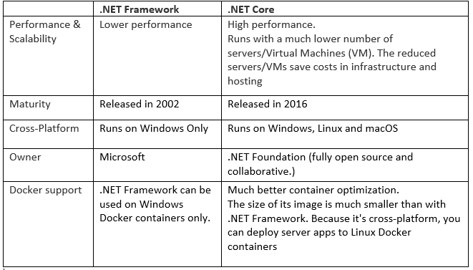
.NET Framework vs .NET Core

Slide 2
Why .NET Core
Asp .NET Core is a cross-platform, high-performance, open-source framework for building modern, cloud-based, internet-connected applications.
Asp.Net Core is redesign of Asp.Net 4.x
You can create .NET Core apps for Windows, macOS, and Linux for x64, x86, ARM32, and ARM64 processors using multiple programming languages. Frameworks and APIs are provided for cloud, IoT, client UI, and machine learning.

Slide 3
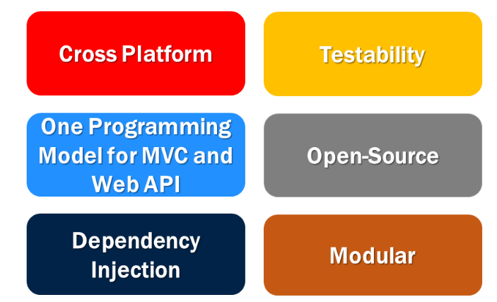
Asp.Net Core Benefit and Features

Slide 4
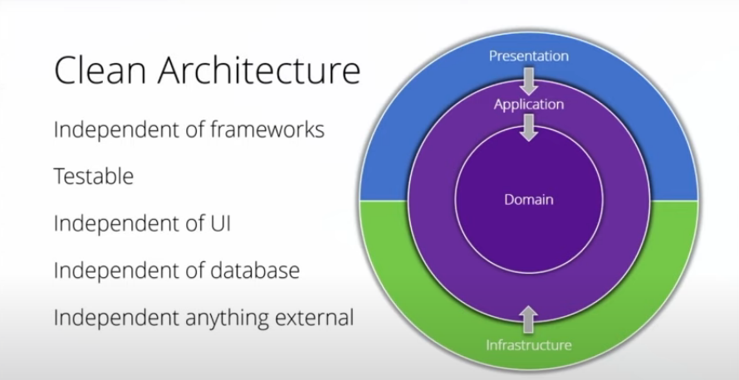
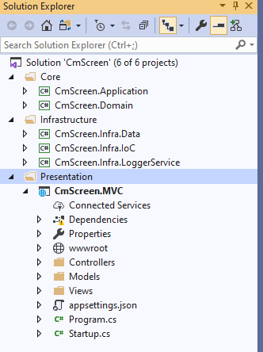
Asp.Net Core Clean Architecture
Business / Application model
--Service
--View model/DTO
Data Access Logic
--Entity Framework
--Repository
-- Exception Logic
--Dependency Injection - IoC
Presentation
(Web MVC)
Infrastructure
(DAL,Log,Repository)
Presentation Logic
--MVC
--Web Api
-- Single Page app
Application
(Service)
Domain

Slide 5
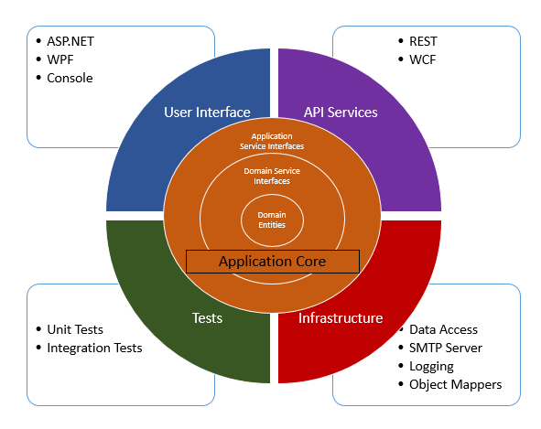
Clean Architecture : Onion Architecture

Slide 6
Clean Architecture Code Walkthrough

